Slide 1
InstantSDK: Your Code, Your SDKs
From Tedious to Effortless - Automating the Documentation Your Users and Customers Need
Jiayi Luo
Aarman Pannu
Harvey Zhao
Ribhav Sahu
Sourav Bhunia

Slide 2
1 | Problem Statement
2 | Solution
3 | Technical Details
4 | Extended Use Cases
5 | Future Roadmap
Agenda

Slide 3
Problem Statement

Slide 4
Problem Statement
Developers encounter numerous challenges in creating and maintaining code documentation and generating Software Development Kits (SDKs). These issues significantly impact their productivity and project timelines.
01
Time Consumption
Developers spend substantial amount of time writing and maintaining documentation
Big detraction from coding and feature development
02
Consistency and Accuracy
Ensuring that documentation is up-to-date and consistent with the codebase is a continuous struggle
Outdated or incorrect documentation leads to confusion and errors
03
Complexity and Comprehensiveness
Creating SDKs requires comprehensive guides, code samples, and integration steps for various use cases and expertise levels
This complexity often results in incomplete or overly complicated SDKs, making them difficult to use and adopt
04
Lack of Standardisation
No universal standard for documentation and SDKs, leading to wide variance in quality and usability
Developers often navigate through poorly documented APIs and SDKs, which can be frustrating and time-consuming

Slide 5
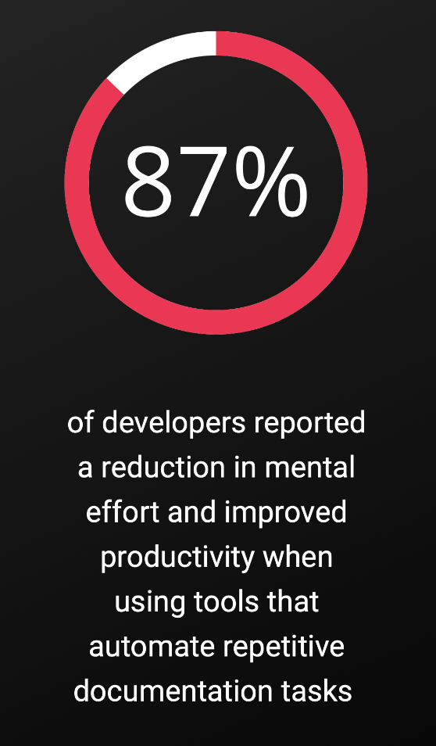
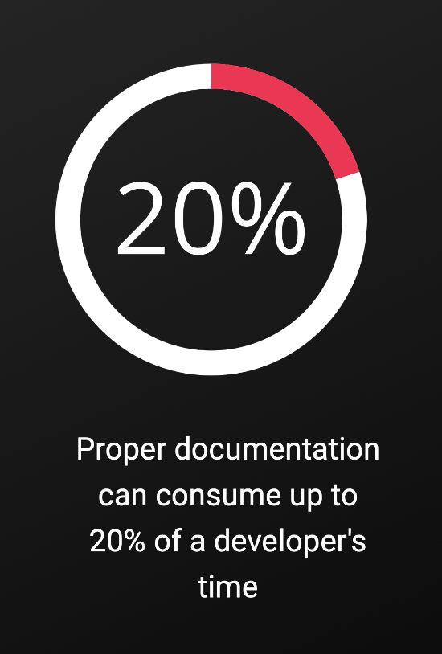
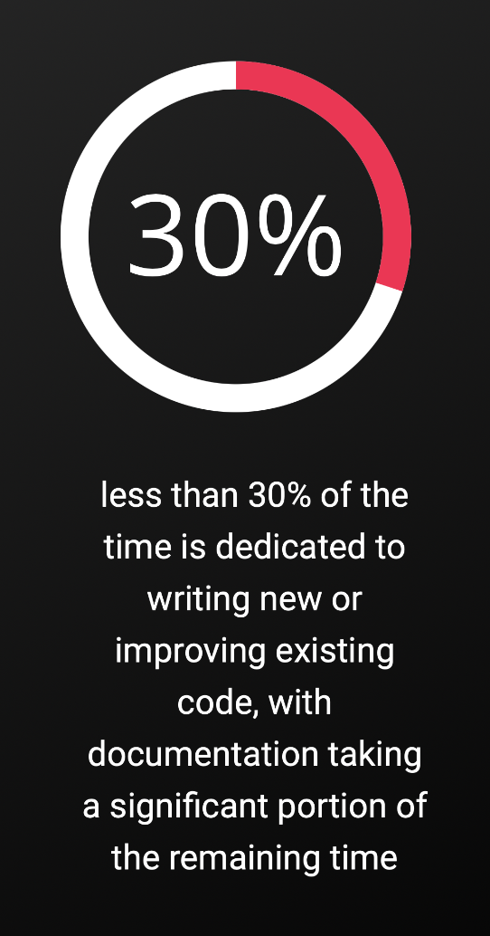
Time Wasted in Documentation
Source: The GitHub Blog
Source: Codeacademy
Source: Tidelift
Notes:
Encoder Only
BERT was the first prominent Encoder Only LLM, introduced in 2018
Combined transformer architecture with bidirectional (uses info from left and right side of word in sentences)
Incredibly effective at understanding semantic meaning of words within their context
Not used at generating text, but understanding relationship of words in a sentence
Used in variety of tasks such as sentiment analysis and improving search queries and web page ranking results in Google’s search engine
Decoder Only
GPT
Focus on generating text, and are unidirectional (predicts next word given previous word)
Can be tailored to variety of different applications with simple prompting and fine tuning
Encoder-Decoder
Best of both worlds:
Encoder: able to capture context and semantics of words based on surroundings
Decoder: able to generate words based on context of encoder
Better at text generation because encoder captures more meaning
Google’s T5 (2019) was one of the first, but people have also been fusing decoder and encoder models such as BERT2GPT2 (2020)
Are really good in Sequence to Sequence translation tasks, such as translating languages and summarizing text

Slide 6
Solution

Slide 7
Feature Highlights
Generate Documentation
Write Example Code
Based on your code, understands context and generates documentation as professional as popular python libraries.
Writes example code to the function you are writing. It helps you and the team to understand your code much better!
Code Commenting
Your source code is private
Our tool comments your code in batches. You can forget about writing comments and focus on getting your work done!
Unlike ChatGPT, we will never use your code to train our model. That means your company does not have to worry about privacy while using AI.

Slide 8
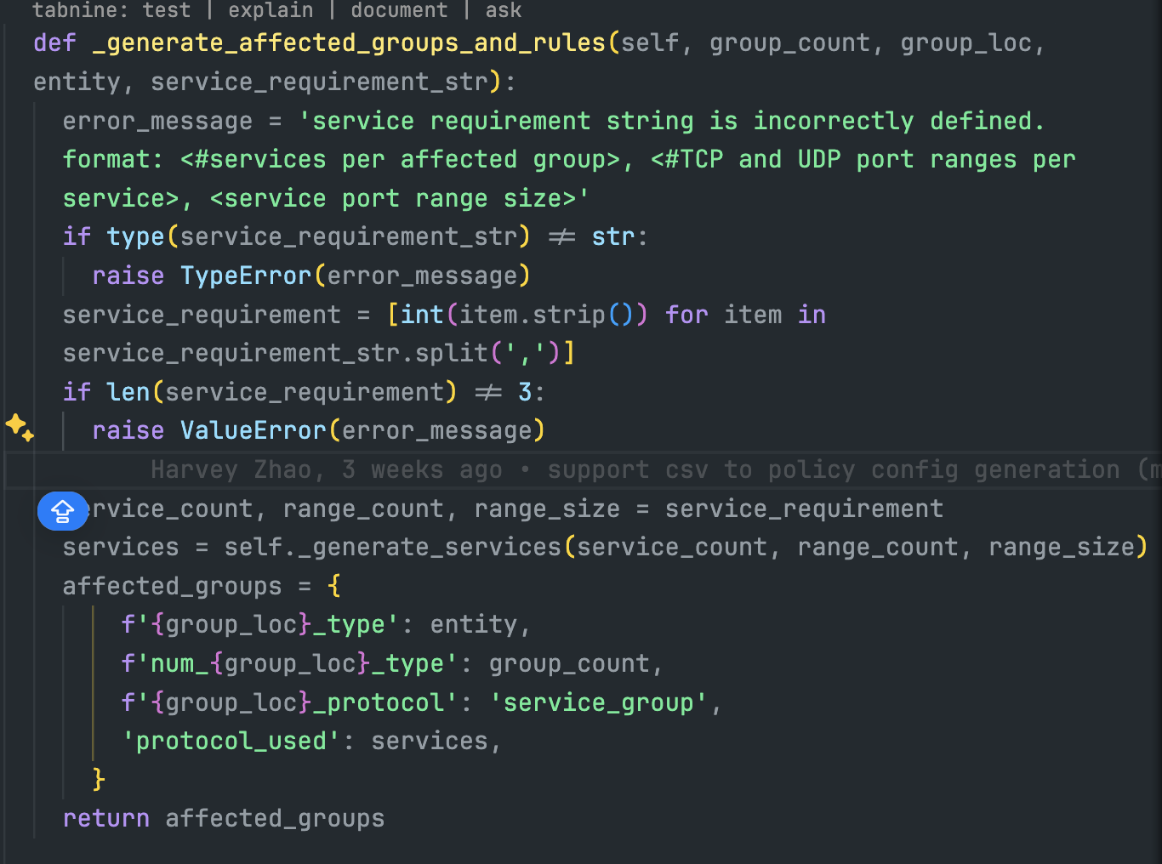

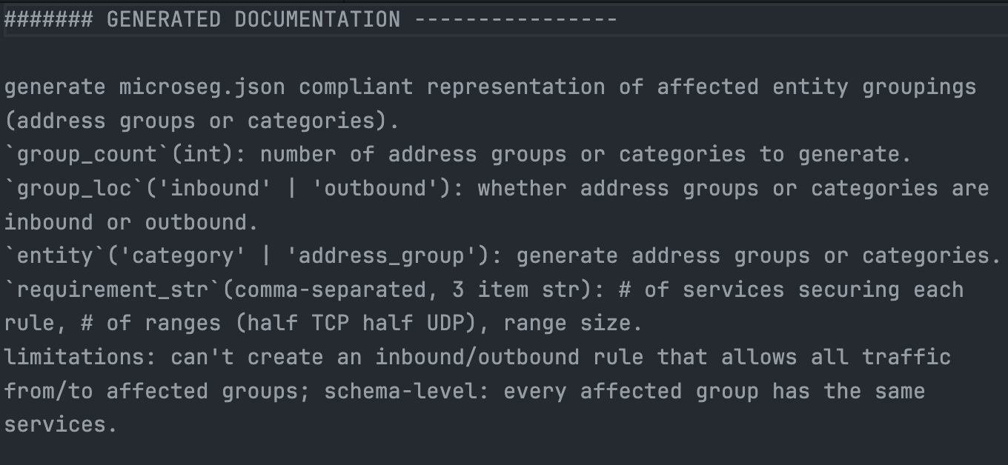
Solution Diagram
Input: Your Codes
InstantSDK
Output: Documentation for your codes

Slide 9
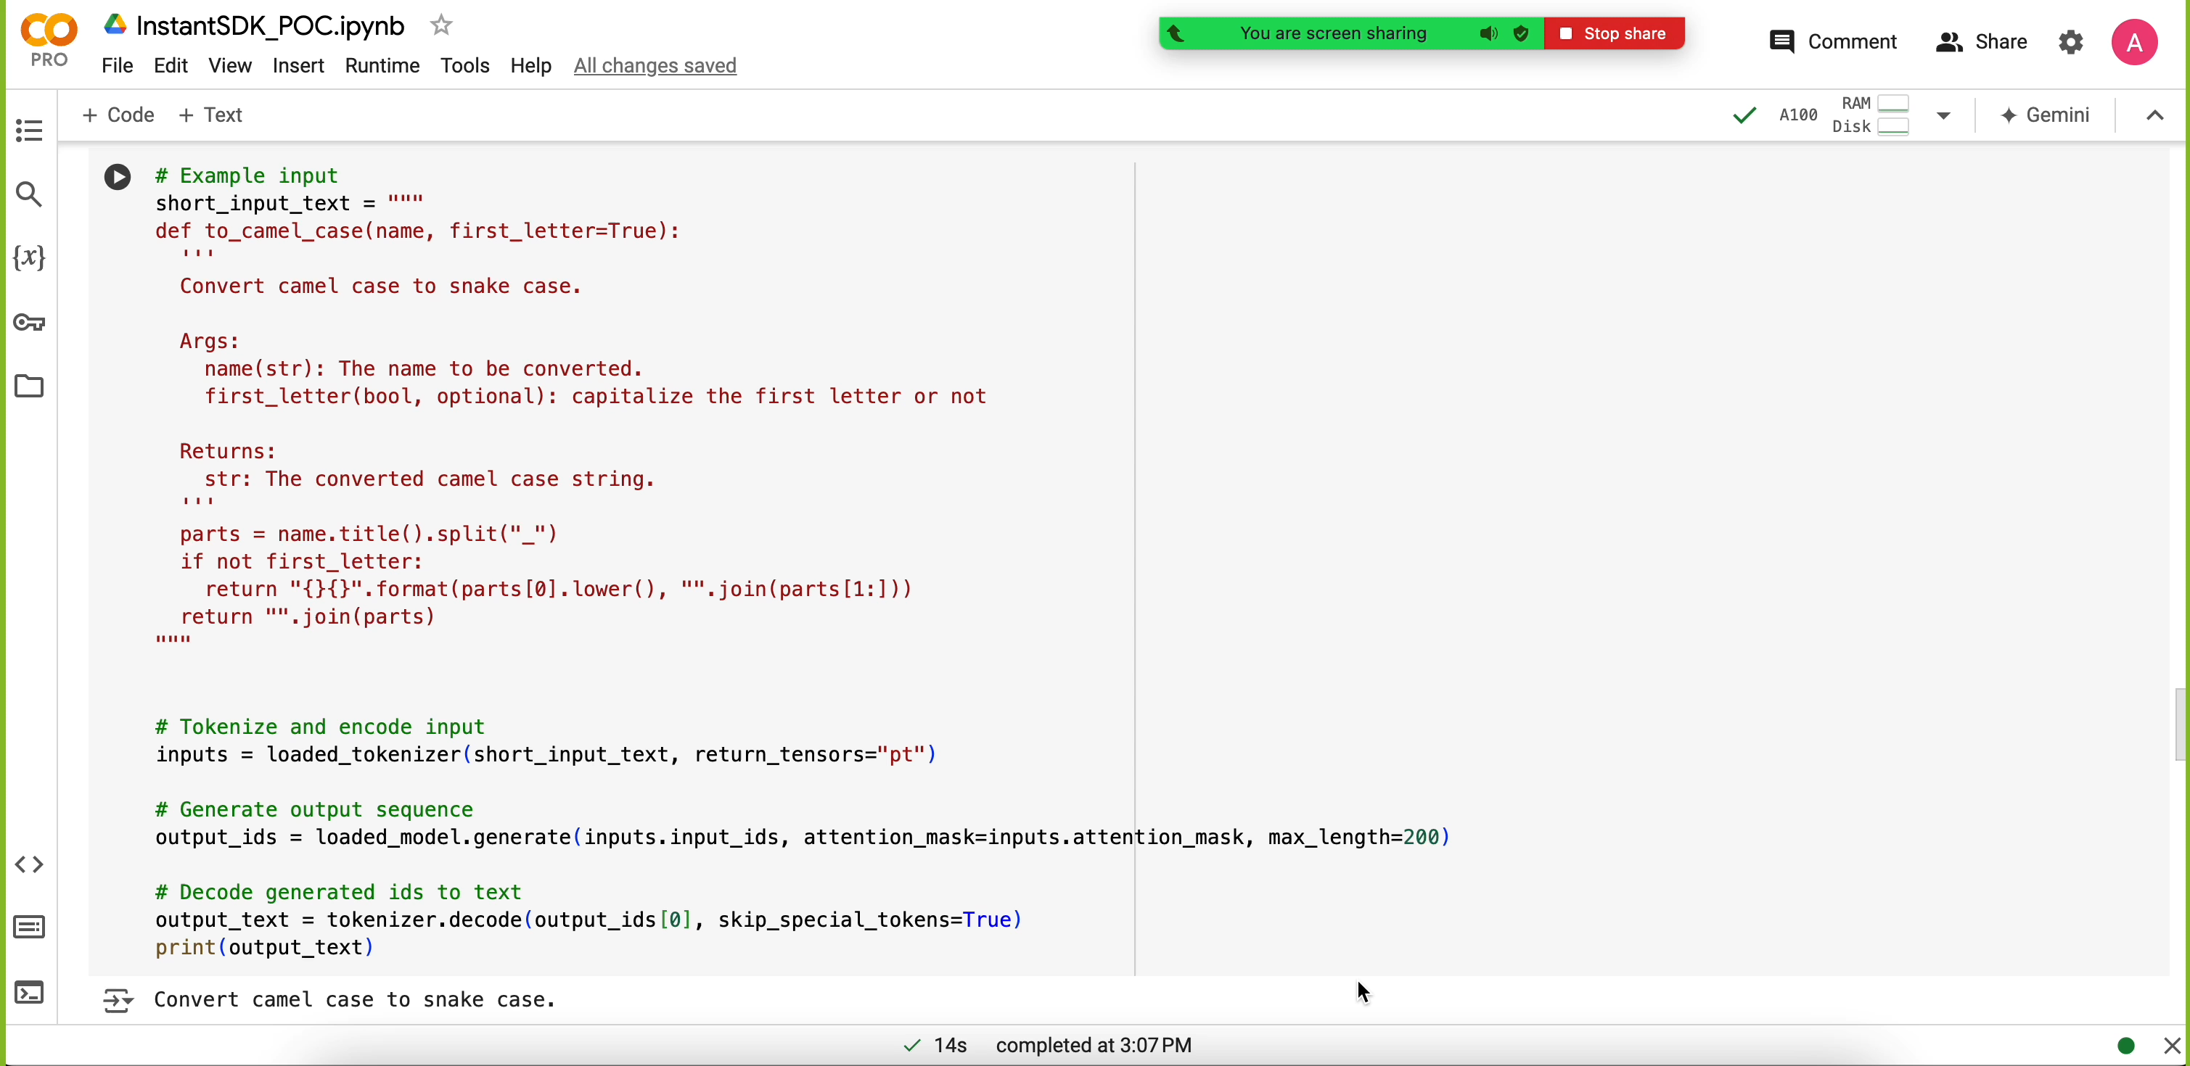
InstantSDK POC DEMO

Slide 10
Technical Details

Slide 11
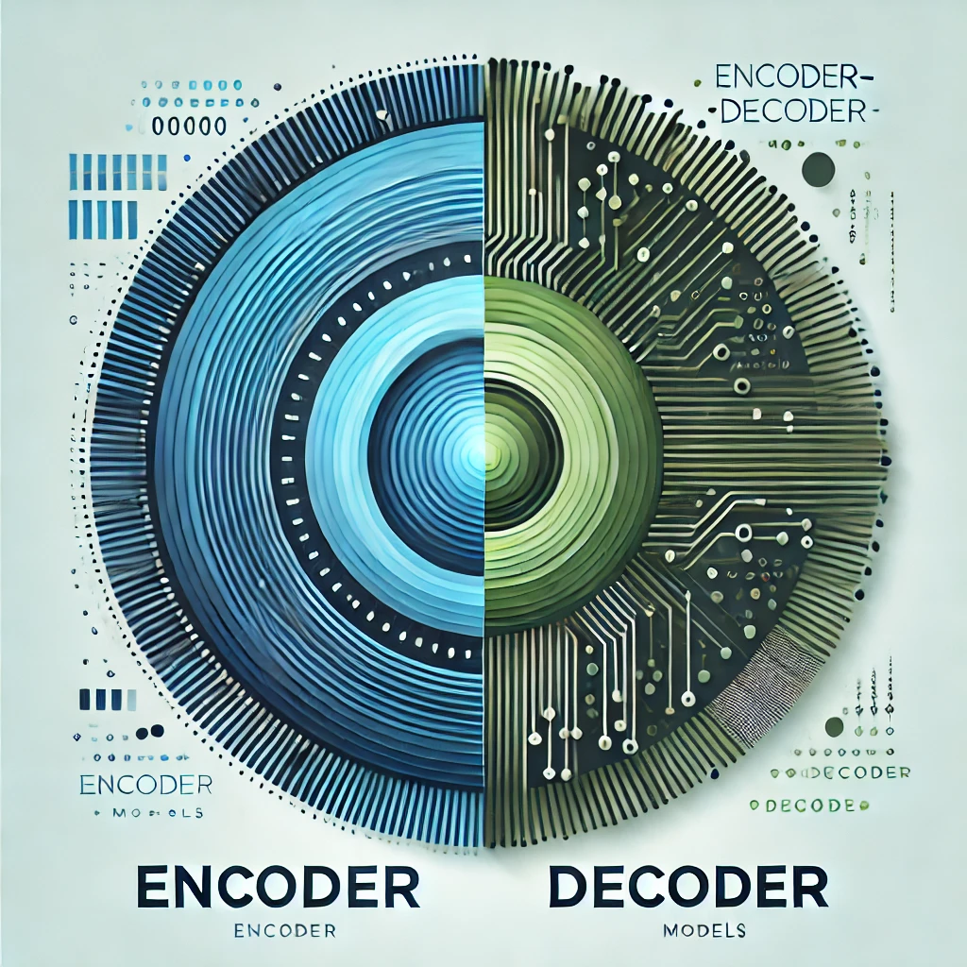
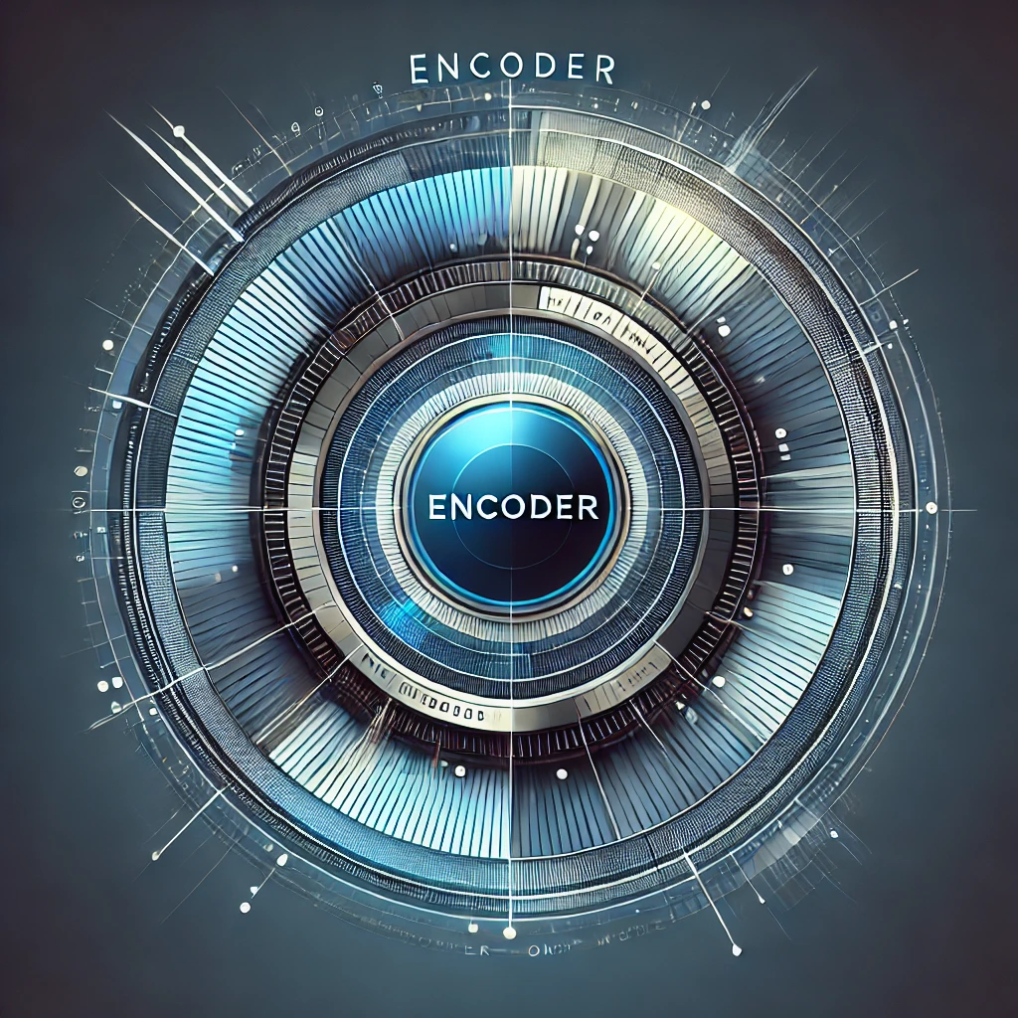

High Level LLM Models
Encoder-Decoder
Best Suited For:
Sequence to Sequence Tasks
Prominent Models:
Google’s T5 (2019)
Google’s BERT2GPT2 (2020)
Facebook’s BART (2020)
Encoder Only
Decoder Only
Best Suited For: Understanding Semantics
Prominent Models:
Google’s BERT (2018)
Facebook’’s RoBERTa (2019)
Best Suited For: Generating Text
Prominent Models:
OpenAI’s GPT-1 (2018)
Anthropic Claude 3 (2024)
Notes:
Encoder Only
BERT was the first prominent Encoder Only LLM, introduced in 2018
Combined transformer architecture with bidirectional (uses info from left and right side of word in sentences)
Incredibly effective at understanding semantic meaning of words within their context
Not used at generating text, but understanding relationship of words in a sentence
Used in variety of tasks such as sentiment analysis and improving search queries and web page ranking results in Google’s search engine
Decoder Only
GPT
Focus on generating text, and are unidirectional (predicts next word given previous word)
Can be tailored to variety of different applications with simple prompting and fine tuning
Encoder-Decoder
Best of both worlds:
Encoder: able to capture context and semantics of words based on surroundings
Decoder: able to generate words based on context of encoder
Better at text generation because encoder captures more meaning
Google’s T5 (2019) was one of the first, but people have also been fusing decoder and encoder models such as BERT2GPT2 (2020)
Are really good in Sequence to Sequence translation tasks, such as translating languages and summarizing text

Slide 12
Encoder-Decoder Model Variants
Final Selected Model
Models experimented with
Pegasus
BART
T5
CodeBERT2GPT
Developed By:
Google
Parameters:
568M
Released:
2019
Validation Loss:
0.141071
Developed By:
Facebook
Parameters:
406M
Released:
2019
Validation Loss:
0.082406
Developed By:
Google
Parameters:
220M
Released:
2020
Validation Loss:
0.245504
Developed By:
Microsoft, OpenAI
Parameters:
242M
Released:
2023, 2020
Validation Loss:
0.680385
Notes:
Utilized the same dataset for fine tuning task based on our data
Note: we fused CodeBERT and GPT2 as CodeBERT is an encoder-only model, specialized on code as an input
Because of time and resource constraints, we trained each of our 4 models for 8 epochs to see which one performed the best
Validation Loss across the same test dataset after fine tuning on the same training dataset for 8 epochs
Cross Entropy Loss
BART was a clear winner so we trained it for 15 epochs to receive a final validation loss of 0.043700

Slide 13
Current Solution Limitations and Next Steps
Data Quality
Resource Constraints
Small Dataset:
Only 800 pairs used
Inconsistent quality across libraries
Other people fine tuning BART typically use ~1M Training Pairs
Parameters in Our Models:
Pegasus: 568M
BART: 406M
T5: 220M
CodeBERT2GPT: 242M
Parameters in Larger Models:
GPT-3.5: 175B
GPT-4: 1.76T
Llama3: 8B
Llama3: 70B
Notes:
Data Quality: because data was scraped from open source libraries, data is inconsistent across libraries
Dataset contained only ~800
CodeBERT2GPT2
Because this was the only fused model, i.e. we stitched two separate models together, it required more training to perform comparably well to
GPT2 is relatively old so could have replaced it with more recent decoder-only models such as
Limited parameter size
We chose the base models so they could be lightweight and low in parameter count because of the time and resource constraints
Larger Encoder-Decoder models such as Llama3 which has a 8B and a 70B parameters
Note: GPT-3.5 has 175B parameters, and GPT-4 has 1.76T parameters
BART and Pegasus which had more parameters significantly outperformed smaller models, we expect fine tuning Llama’s 8B parameters to yield significant improvements

Slide 14
Extended Use Cases

Slide 15
Automated Code Commenting
Key Features
Contextual Understanding:
Analyzes code structure and logic to provide meaningful comments.
Customization:
Allows developers to set specific commenting standards and styles.
Integration:
Easily integrates with popular IDEs and version control systems.
Industry Validation
Example: DeepCode, acquired by Snyk, provides similar AI-driven code reviews and comment generation.
Benefits
Increased Productivity:
Reduces time spent on writing comments. A study by Stripe estimates that developers spend around 17.3 hours per week dealing with code maintenance, which includes writing comments.
Improved Code Quality: Enhances code readability and maintainability.
Consistency: Ensures uniform commenting standards across projects.
Introduction
Challenge: Developers often spend a significant amount of time writing comments to make code understandable and maintainable.
Impact: Time spent on commenting can delay project timelines and affect productivity. According to a survey by JetBrains, developers spend approximately 15-25% of their time on documentation, including comments.
Solution Overview
Automated Comment Generation Tool:
Uses advanced language models to understand the code context and generate relevant comments automatically.
Ensures consistent and high-quality comments across the codebase.

Slide 16
Comprehensive API Documentation
Key Features
Real-Time Updates:
Automatically updates documentation with every code change.
Multi-Format Support:
Generates documentation in various formats (HTML, Markdown, PDF).
Search and Navigation:
Includes search functionality and easy navigation through API endpoints.
Industry Validation
Example: Postman offers automated documentation generation as part of their API platform, streamlining the API development lifecycle. Learn More
Benefits
Time Savings:
Drastically reduces the time spent on manual documentation. Research shows that poor documentation costs the industry $1.2 trillion annually in lost productivity.
Accuracy: Ensures documentation is always in sync with the latest code.
Enhanced Developer Experience: Provides clear and accessible API documentation for users.
Introduction
Challenge: Creating detailed and accurate API documentation is time-consuming and prone to errors. According to Postman’s State of the API Report, 49% of developers consider the lack of detailed documentation a significant issue.
Impact: Incomplete or outdated documentation can hinder API adoption and integration.
Solution Overview
Automated API Documentation Tool:
Generates comprehensive API documentation directly from codebases.
Ensures documentation is always up-to-date with code changes.

Slide 17
Code Translation between Languages
Key Features
Multi-Language Support:
Handles translation between major programming languages (e.g., Python to Java, JavaScript to TypeScript).
Syntax and Semantic Preservation:
Maintains the original code’s logic and functionality.
Customizable Rules:
Allows for customization to match specific coding standards and practices.
Industry Validation
Example: Sourcegraph offers automated code translation and refactoring tools, helping developers manage multi-language codebases efficiently. Learn More
Benefits
Reduced Effort: Minimizes the need for manual translation.
Faster Development: Speeds up the process of adopting new languages and frameworks. Data shows developers spend an average of 13.5 hours per week dealing with technical debt, which includes language translation issues.
Consistency: Ensures consistent code quality across different languages.
Introduction
Challenge: Translating code from one programming language to another is a complex and error-prone process. According to a Stack Overflow Developer Survey, 48.3% of developers work in multiple programming languages.
Impact: Language-specific expertise and manual translation efforts can slow down project timelines.
Solution Overview
Automated Code Translation Tool:
Converts code from one programming language to another with high accuracy.
Supports multiple programming languages and frameworks.

Slide 18
Future Roadmap

Slide 19
Phased Development Plan
Phase 1: Proof of Concept (POC) Enhancement (1 Month)
Development: Enhance current BERT model for improved contextual understanding. Fine-tune the model with diverse code snippets and documentation styles specific to Nutanix projects. Build VS-Code Extension.
Data: Internal Nutanix codebases with existing SDKs for customers. Open-source repositories relevant to Nutanix technologies.
Milestones and Expected Outcomes: Demonstrate successful generation of documentation for a diverse set of code snippets.
Metrics Tracking: BLEU score for documentation generation. Initial user satisfaction ratings from internal developer testing.
Feedback Incorporation: Collect developer feedback through structured surveys and focus group sessions. Refine model iteratively based on feedback to address key issues.
Phase 2: Multi-Language Support (3 Months)
Development: Expand the model to support multiple programming languages beyond Python and JSON (e.g., Java, JavaScript, C#, Go). Implement automatic language detection and appropriate model application.
Data: Nutanix’s multi-language codebases. Open-source multilingual code repositories.
Milestones and Expected Outcomes: Seamless documentation generation for at least five programming languages. Consistent performance across all supported languages.
Metrics Tracking: Language-specific accuracy and performance metrics. Adoption rates by Nutanix developers.
Feedback Incorporation: Regular feedback sessions with developers from teams privy to initial roll-outs using team-specific learning sessions.
Phase 3: User Interface and Experience (UI/UX) Development (1.5 Months)
Development: Design and develop a user-friendly interface for the SDK generator. Ensure easy integration with Nutanix’s existing development environments.
Milestones and Expected Outcomes: Intuitive interface with seamless navigation. High user satisfaction scores in UI/UX testing.
Metrics Tracking: User engagement metrics (time spent * number of interactions). UI/UX satisfaction ratings from internal surveys.
Feedback Incorporation: Conduct beta testing with Nutanix developers. Refine UI/UX based on feedback.
Phase 4: Integration with Nutanix Development Tools (4 Months)
Development: Develop plugins/extensions for Nutanix’s internal development tools and environments. Ensure seamless functionality and minimal performance overhead.
Milestones and Expected Outcomes: API documentation for internal tool integration. Functional plugins/extensions for major Nutanix development tools. High adoption rates among Nutanix developers.
Metrics Tracking: Plugin download and usage statistics. Performance metrics (Speed of SDK - productivity increase) of plugins.
Feedback Incorporation: Continuous improvements based on user input.
Phase 5: Full Product Roll-Out and Internal Training (1 Month)
Development: Finalize all features and ensure product stability. Develop comprehensive training programs for Nutanix developers tailored to Nutanix’s development practices.
Milestones and Expected Outcomes: High adoption and engagement rates among Nutanix developers. Reduced code documentation time and adherence to best practices.
Metrics Tracking: User satisfaction. Training program effectiveness (post-training competency assessments).
Feedback Incorporation: Post-training feedback collection.
Phase 6: Post-Launch Support and Continuous Improvement (Ongoing)
Development: Establish monitoring and support team. Regular updates and feature additions based on user feedback.
Milestones: Regular release of new features and improvements.
Metrics Tracking: Support response time. User satisfaction and net promoter scores (NPS).
Feedback Incorporation: Continuous improvement based on ongoing feedback. Regular communication with users about updates and improvements.

Slide 20
Thank You

